Slide 1
Mercer on Mission Cambodia 2022 Instrumentation of Fitting Prosthetics EGR 292/BME 492/592
Fitting the Below-Knee Prosthesis

Slide 2
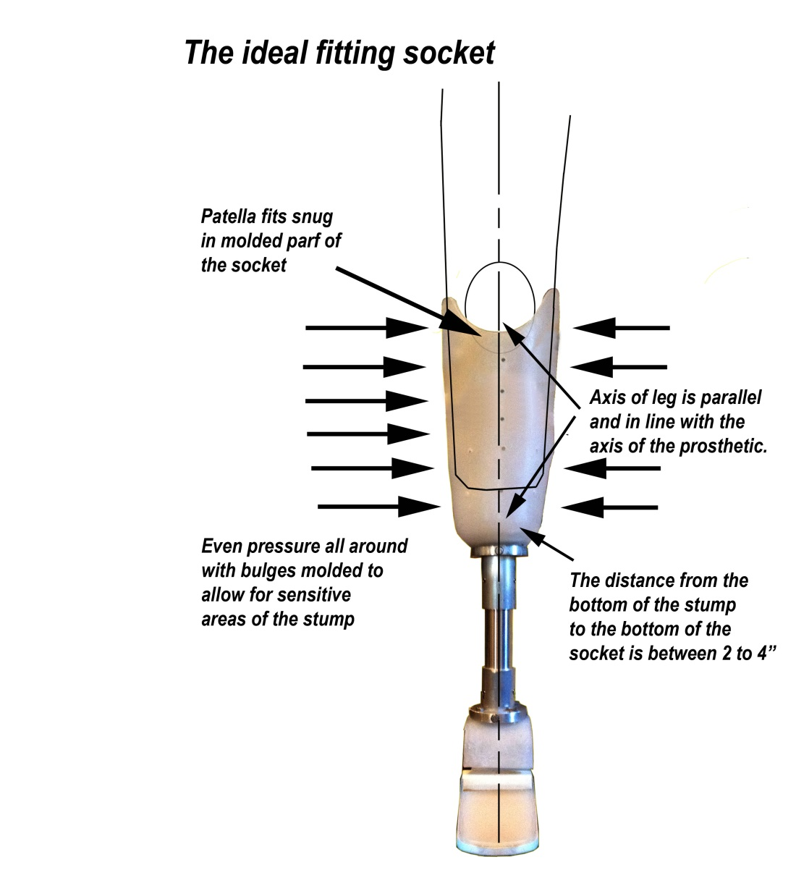
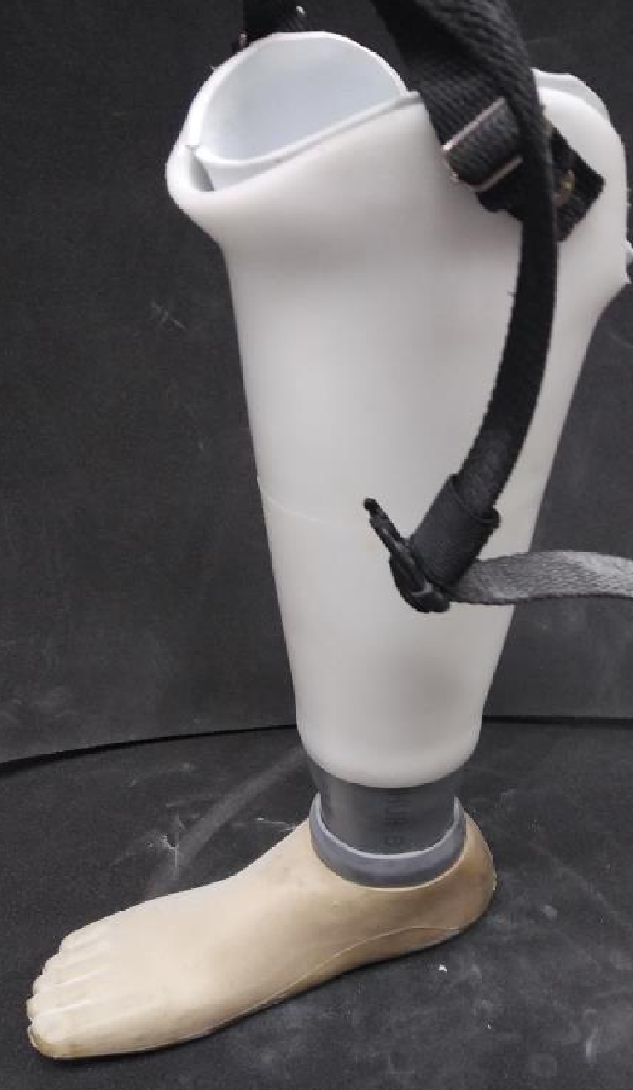
Parts of the BK Prosthesis
Knee Strap
Socket
Patella bearing insert
Foam Insert
Internal (distal) plate
Proximal Flange
Pylon
Distal flange/foot assembly
Foot cover

Slide 3
BK Socket Sizes
Standard Sockets
Small: 34 cm circumference
Short: 28 cm length
Medium: 34 cm length
Extra long: 45 cm length
Medium: 38 cm circumference
Medium: 34 cm length
Large: 40 cm circumference
Long: 41 cm
Irregular sockets (various sizes)
Foam Inserts
4 mm thick

Slide 4
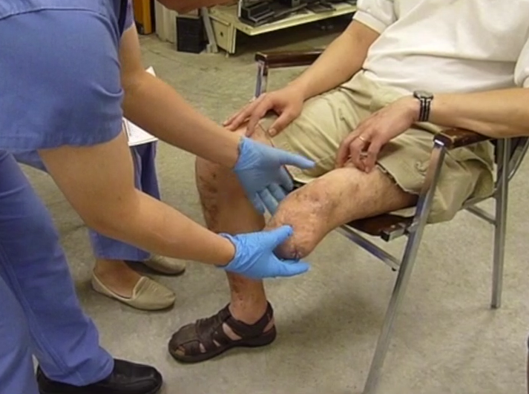
Gather and Record Patient Information
Greet patient, smile, introduce yourself
Verify patient tag with intake form
Put a small piece of black tape on the patient’s ID tag
Check for special medical concerns
Hypertension, diabetes, etc.
Inspect residual limb and record:
Range of motion and muscle strength of both legs
Fitting concerns: edema, neuropathy, wounds or sensitive areas, boney protrusions, valgus/varus
Put a sock on the patient’s stump and record:
Stump size measurements

Slide 5
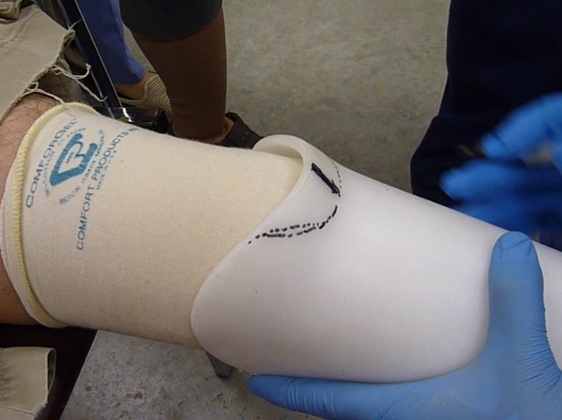
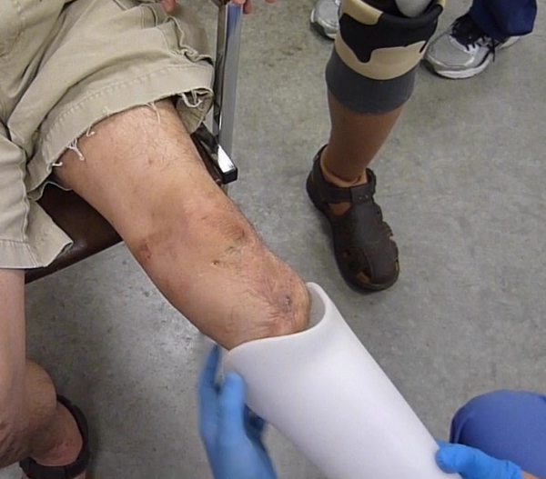
Socket Selection and Initial Fitting
From inventory:
Select a socket
Pick up a foam sleeve
Test fit the socket with/without foam sleeve
Socket should slide up to the patella with a snug and straight fit
If socket is valgus/varus or causing pain, identify and execute preliminary modifications, e.g.
Trim the foam at bony protrusions
Heat and flare the wings of the socket
Heat and bubble the socket to accommodate protrusions
Add extra foam at local areas

Slide 6
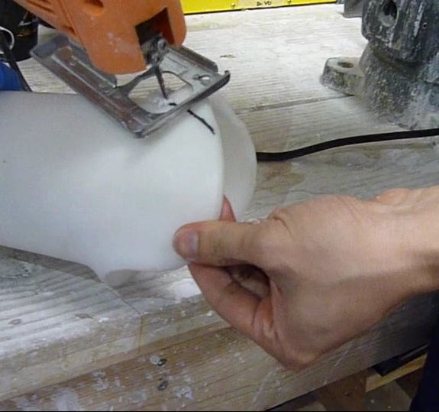
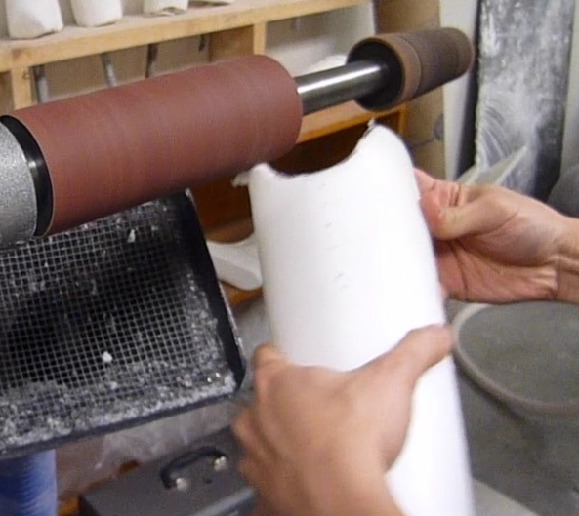
Modify the socket as needed
Trimming
Grinding/smoothing

Slide 7
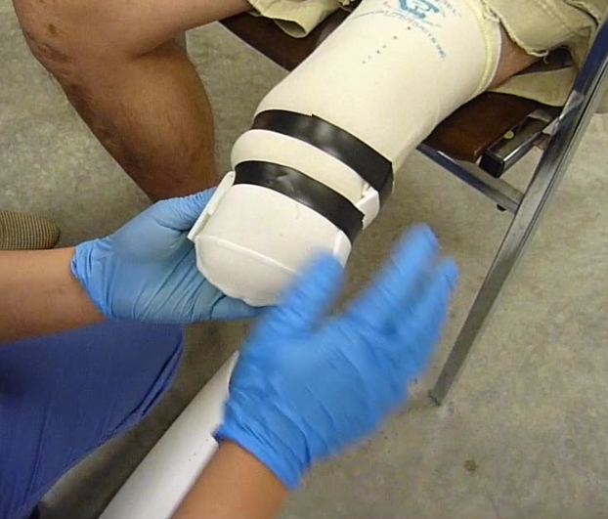
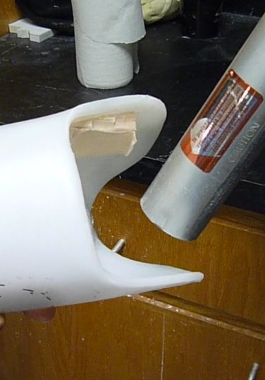
More socket modifications
Extra foam padding
Heating/bubbling

Slide 8
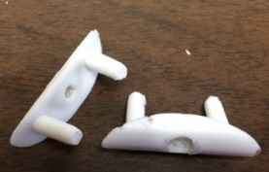
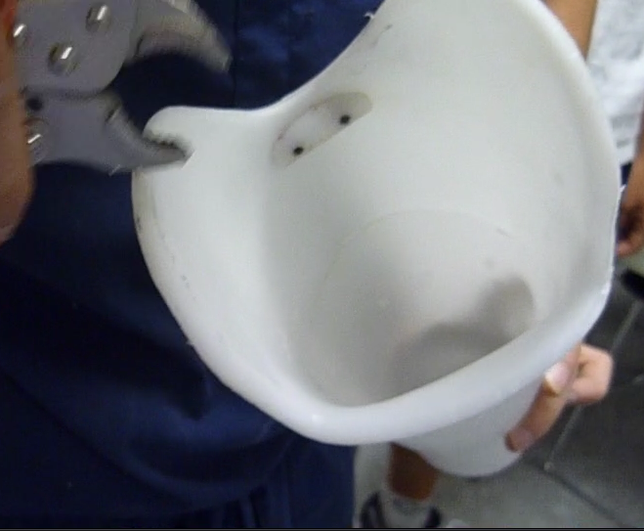
Install Patella Bearing Support
Patella bearing support is located inside the socket just below the patella
Using template, drill 2 5mm holes to line up with posts on patella bearing
Insert patella bearing inside the socket
Drill pilot hole through socket aligned with center hole on patella bearing
Insert small wood screw to secure patella bearing
Break/grind off end of screw and plastic posts on outside of socket
Patella bearing support installed

Slide 9
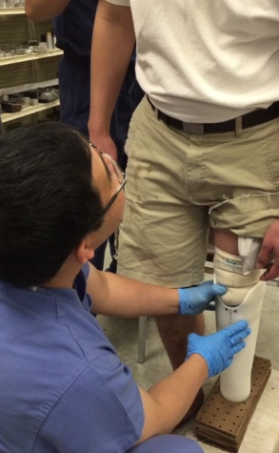
Patient Comfort When Bearing Weight
If preliminary mods appear satisfactory, have the patient stand and bear weight on the socket
Continue socket modifications until
Patient is comfortable when bearing weight
Socket is straight and stable
Communicate with the patient

Slide 10
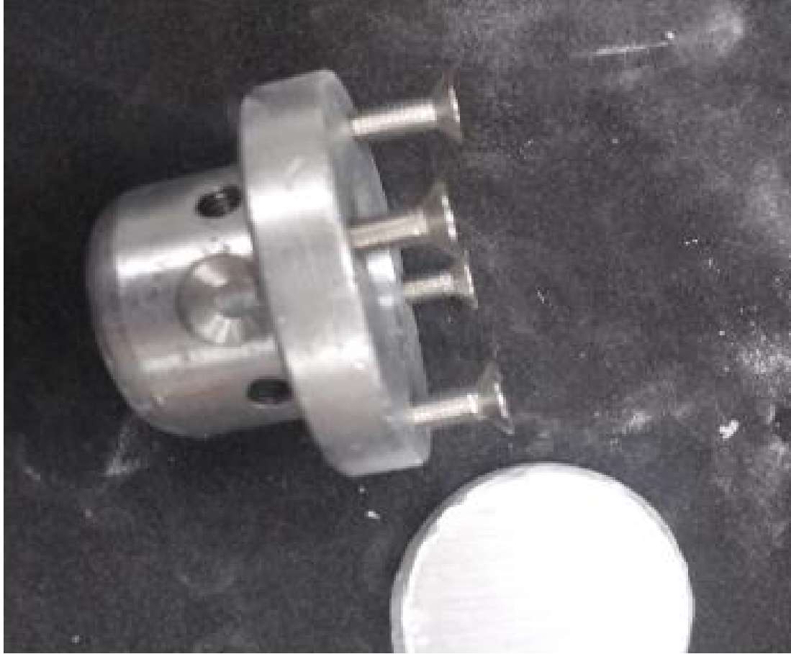
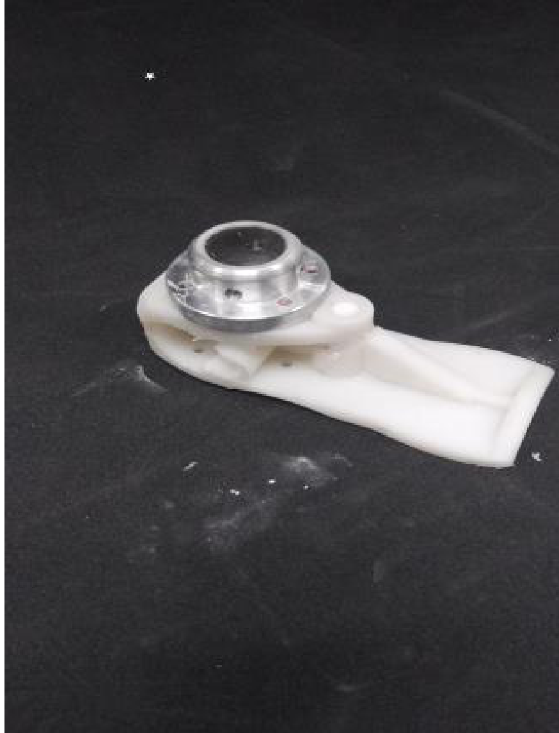
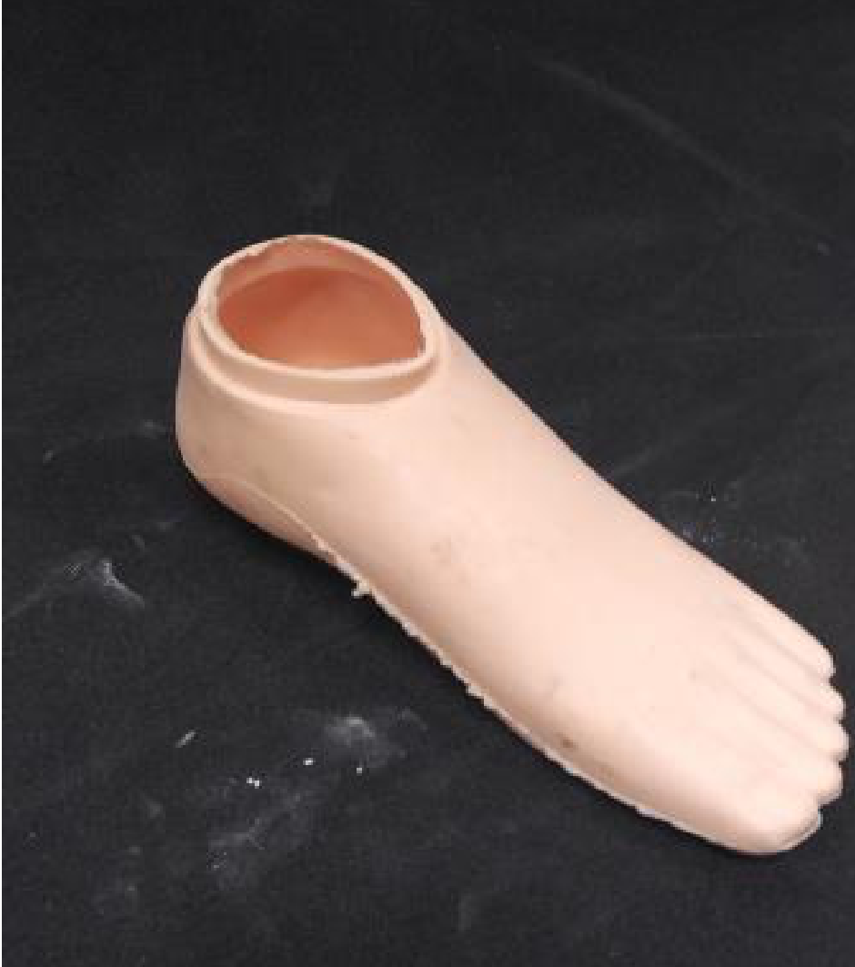
Complete the Prosthesis Assembly
From inventory, collect parts:
Distal plate/proximal flange assembly
Foot
Foot cover
Insert 4 set screws each in proximal flange and distal flange (already attached to foot
Assemble foot inside foot cover
Distal plate/proximal flange
Foot with distal flange
Foot cover

Slide 11
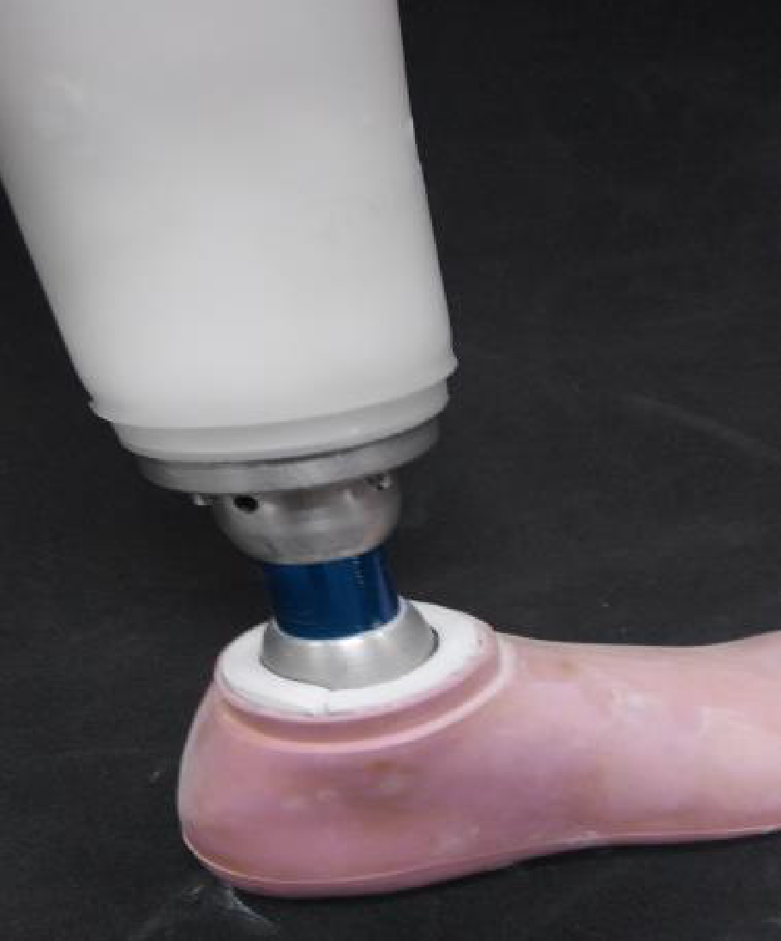
Assemble Plate/Flange to Socket
Attach distal plate/proximal flange to distal end of socket
Distal plate is inserted into the socket
Four holes are drilled in base of socket using small step bit
Proximal flange is attached using four screws through the plate and socket base into the flange

Slide 12
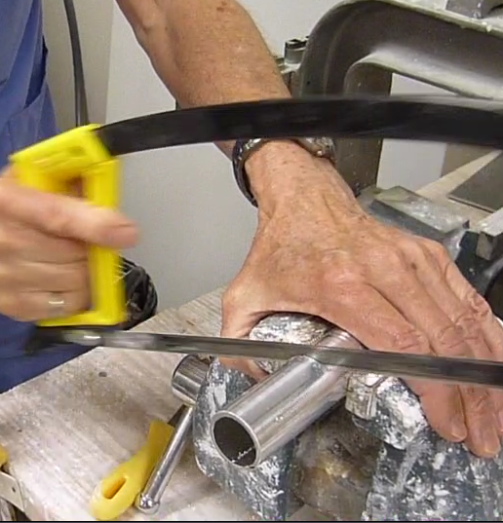
Assemble Foot Assembly to Socket
With the patient sitting, estimate pylon length
Cut a pylon ~1 cm longer than estimate
Insert one end of pylon into proximal flange, other end into distal flange
Set gait angle of foot
Align midline of socket between big toe and second toe of foot shell
Tighten all 8 set screws

Slide 13
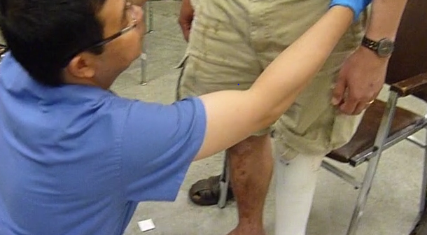
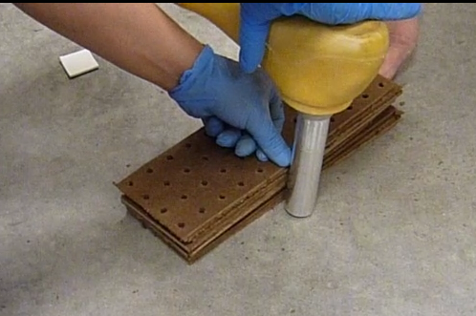
Adjust Limb Length
Fit socket to patient
Have patient stand
Shoe off
Bear weight equally on both legs
Feet together
Palpate ASIS to determine limb length discrepancy
If prosthesis is too long, add wooden shims under natural foot until level
Remove pylon and mark it for cutting using the stack of shims
Cut the pylon
Reassemble
Fit to patient, confirm limb length

Slide 14
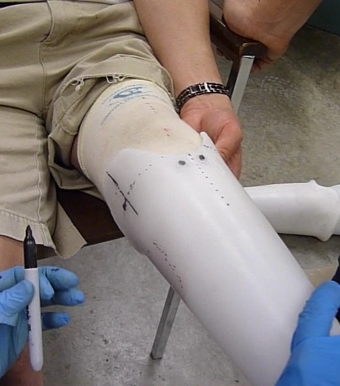
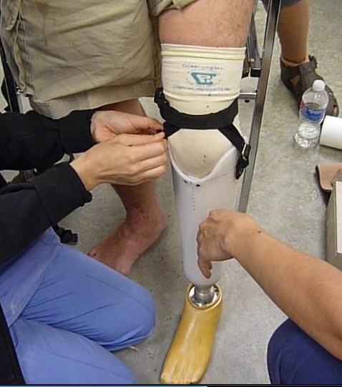
Install Knee Strap
Mark holes for knee strap
1 mounting hole each side
Holes at level of distal aspect of patella
1-1.5 cm posterior to midline of socket
Drill 5 mm holes
Tap
Install with temporary screws
Adjust so belt fits snugly superior to patella
Adjust tension in connecting straps

Slide 15
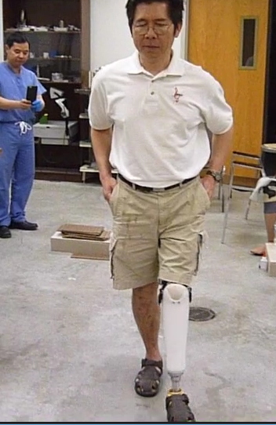
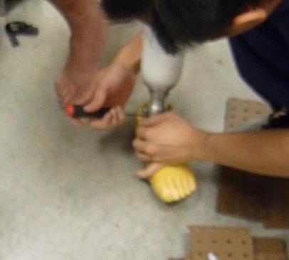
Assist Patient in Walking
Check gait angle of foot
Tighten all set screws!
Observe and assist as patient walks
Comfort – Alignment
Stability – Gait
Patient satisfaction – Pistoning, rotation
Modify as necessary, repeating above steps, until both you and the patient are satisfied.

Slide 16
Approvals
Especially early on have a faculty member do pre-check of the fit
If given go-ahead:
Let it be known that you are ready for Dr. Vo to evaluate
While waiting for Dr. Vo, you can begin final safety/cosmetic tasks below
When Dr. Vo checks the patient, he will observe the patient’s gait and chat with the patient
If he approves, he will sign the intake form
If not, he will recommend changes

Slide 17
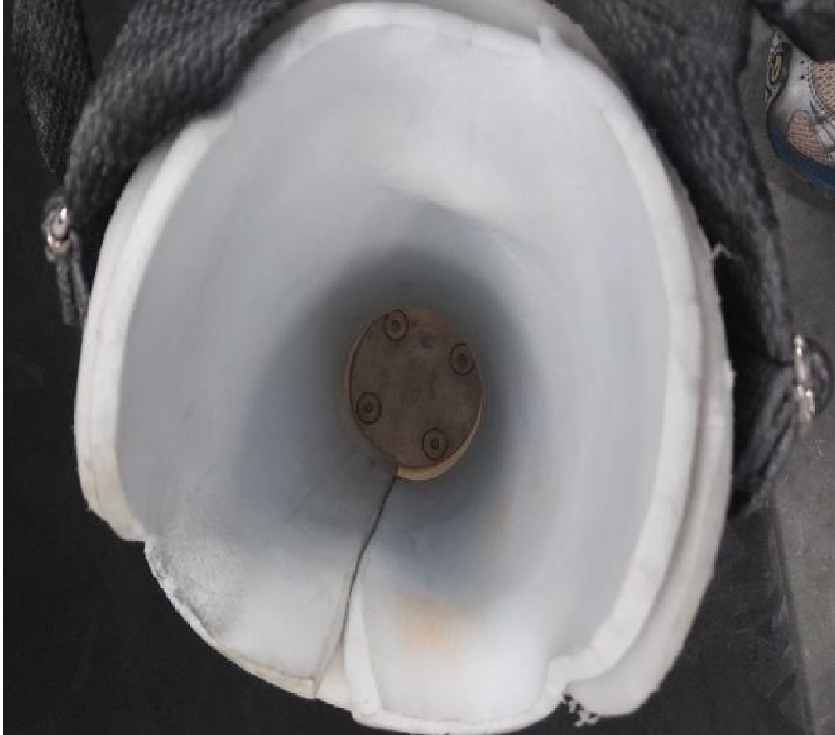
Final Safety and Cosmetic Tasks
At both proximal and distal flanges, drill (5 mm), tap and install through bolts
At proximal flange, Loctite all set screws and through-bolt; tighten securely with drill
Replace temporary strap screws with brass rivets
Cut air/access hole on medial side of socket (large step bit)
Glue foam using Super Glue

Slide 18
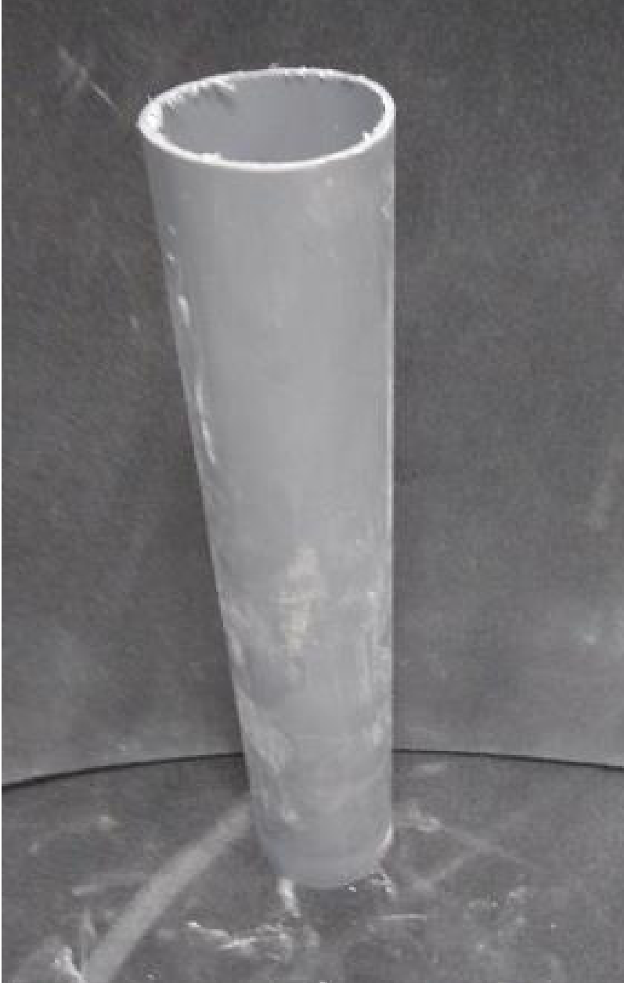
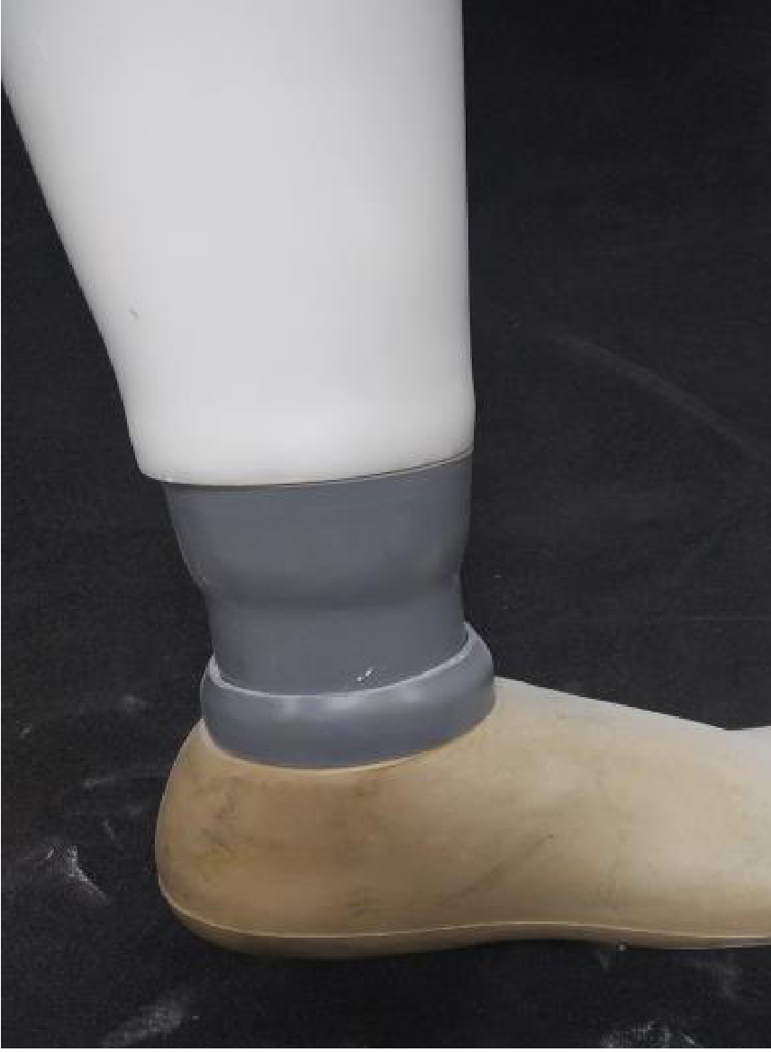
Final Safety and Cosmetic Tasks
Cut and flare grey PVC cosmetic piece
Cut “mouse-hole” at unflared end
Remove the foot, install flared grey piece and flared grey ring, reinstall foot
Loctite all set screws and through bolt; tighten securely with drill
Seal all joints with Super Glue and silicone
Double-check everything with your partner!
Grey PVC
Prosthesis with grey cosmetic pieces installed

Slide 19
Check Out
From inventory, get a pair of shoes for the patient
Present the finished prosthesis to the patient with a smile!
Put shoes on prosthesis and patient’s natural foot
Patient may wish to try on finished prosthesis and wear it out, or may not
Take a photo of patient with the team if you wish
Escort the patient with signed form to pharmacy for discharge

Slide 20
Final Comments
The procedure described here should be generally followed for each BK patient
Since each patient is different, there may be variations in the process to accommodate the patient’s specific needs
Any substantial variations should be discussed and approved by faculty
The patient’s safety and specific needs are the foremost requirements

